Slide 1
Unit-1 Transformer

Slide 2
What is transformer?
Transformers are electrical devices used to convert or "transform" AC voltage from one level to another. (high to low or low to high)
Input and output are AC
They do this by the principle of electromagnetic induction

Slide 3
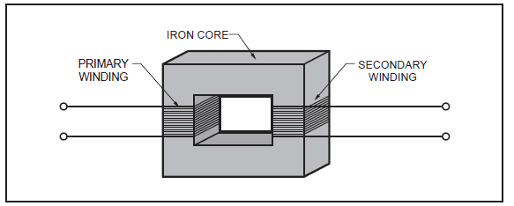

Slide 4
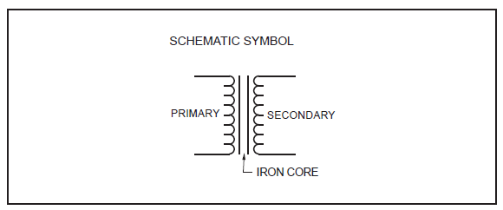
Symbol of Transformer

Slide 5
Transformer Operation
An electrical transformer normally consists of a ferromagnetic core and two coils called "windings".
A transformer uses the principle of mutual inductance to create an AC voltage in the secondary coil from the alternating electric current flowing through the primary coil.
The voltage induced in the secondary can be used to drive a load.

Slide 6
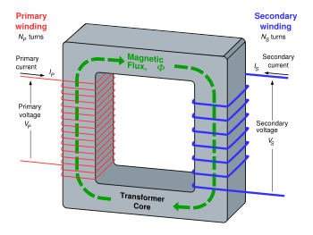
Transformer Structure

Slide 7
Transformer Operation
The working principle of transformer is very simple. It depends upon Faraday's law of electromagnetic induction. Mutual induction between two or more winding is responsible for transformation action in an electrical transformer. Faraday's Laws of Electromagnetic Induction
According to these Faraday's laws, "Rate of change of flux linkage with respect to time is directly proportional to the induced EMF in a conductor or coil".

Slide 8
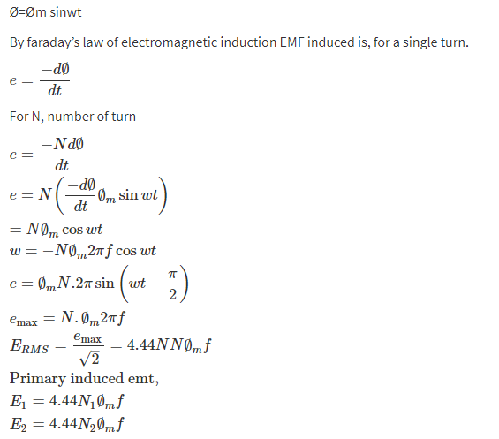
EMF Equation of transformer
Consider AC Sinusoidal flux

Slide 9
Transformation Ratio “K”
The transformation ratio is defined as the ratio of the secondary voltage to primary voltage. It is denoted by the letter K.

Slide 10
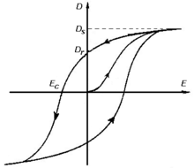
Types of losses in Transformer
1) Copper loss
2) Iron loss :-
a) Hysteresis loss
b) Eddy current loss

Slide 11
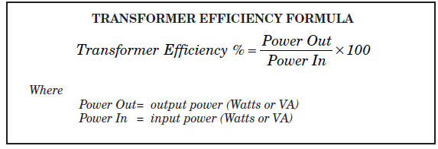
Transformer Efficiency
The power loss is converted to heat . The heat produced can be found by calculating the transformer efficiency.

Slide 12
Voltage Regulation of Transformer
The voltage regulation is the percentage of voltage difference between no load and full load terminal voltages of a transformer with respect to its full load voltage.

Slide 13
Problems
A transformer has a primary voltage of 230v and turns ratio of 5:1. Calculate the secondary voltage
A transformer has 200 turns in the primary, 50 turns in the secondary, and 120 volts applied to the primary (V_{p}). What is the voltage across the secondary (V _{s})?

Slide 14
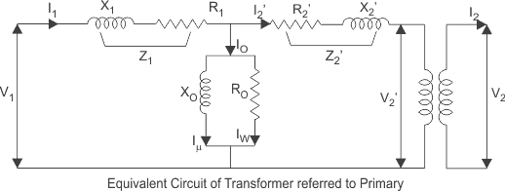
Equivalent circuit of Transformer

Slide 15
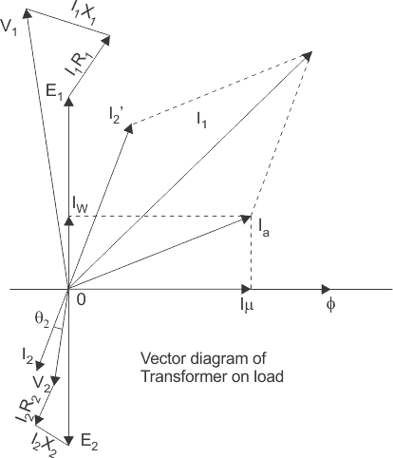
Phasor Diagram

